Slide 1
Anukalp engineering india pvt ltd
We take care of all your Needs…. ….

Slide 2
Short overview
Complete Data Center, Control Command Center& Turnkey Projects Solutions, Railway-Metro Projects, Wearhouse Projects………….

Slide 3
About company
"Anukalp Engineering Started in 2014 and operated by qualified & Experienced Data Centre & MSC professionals. Anukalp designs, builds, and services critical infrastructure like Data Centers, Wearhouse, civil & electrical work that enables vital applications....

Slide 4
Company VISION
Pride ourselves working on latest technologies and each aspect of telecommunication , infra and equipped with latest tools, Equipment's & Training, Dedicated team and Ancillaries to each Project. We believe that building strong client relationships is incredibly important and we work closely with our clients to engender complete trust. We will listen to your vision and work to strict deadlines or take on longer term projects that involve deeper thought.

Slide 5
About us
Mr. Vishwanath Dhatrak is a Managing Director in organization who is having Electrical Engineering background and carried Industrial Safety Diploma from Mumbai. Mr. Vishwanath is having more than 23 years experience in the Industry in which he has worked more than 15 years in Data Centre Project implementation. He is also expert to designing of Data Centers Projects. He is also consulting to many customer for their project implementation.

Slide 6
Co-director
Mrs. Deepali Vishwanath Dhatrak is a Director having MBA in financial management from Mumbai university. She is help us to company financial credentials. Identifying what needs to happen financially for the company to achieve its short- and long-term goals. Leaders need insights into current performance for scenario planning. Helping business leaders decide the best way to execute on plans by providing up-to-date financial reports and data on relevant KPIs. Ensuring each department is contributing to the vision and operating within budget and in alignment with strategy.

Slide 7
We believe our team
Mr. VIKAS JADHAV
Ms. Neha pagare
Mr. abhishek khawade
Mr. MAYUR BALSARAF
Mr. Vikas Jadhav is Diploma in Civil Engineering as well as Surveyer from VJTI from Mumbai university. He is handling 29 Years Experience and he is handling Project Delivery.
Ms. Neha is graduate in Civil engineering from Mumbai university. She is working with project co-Ordinator.
Mr. Abhishek Khawade is graduate in B. Tech Civil Engineering. He is working as a Site Engineer.
Mr. Mayur Basaraf is graduate in Civil Engineering from Pune university. He is working as a Site Engineer.
.

Slide 8
We believe our team
Mr. Sharad Bhavsar
Mr. Nitin bhalse
Mrs. Sushma Jaiswar
Mr. ROSHAN Mungekar'
Mr. Shard Bhavsar is graduate in Electrical Engineering. He is handling AMC’s for Madhya-Pradesh.
Mr. Nitin Bhalse is graduate in M. Tech in Civil Engineering. He is handling road construction projects and Survey projects.
Mrs. Sushma Jaiswar is graduate in Bachelor in commerce from Mumbai University. She is handling Account, HR, and Admin.
Mr. Roshan Mungekar' is graduate in Bachelor in commerce from Mumbai University. He is handling Pre-sales & Purchase.

Slide 9
Our goal
Integrity
Trust
Ownership
Quality Assurance
On Time Delivery
Anukalp

Slide 10
WHAT WE DO ?
Consultancy Projects
Metro Rail Projects
Data Centre
Turnkey Solution
Design, Construction & Maintains
Railway Projects
MEP Projects
Smart Row Projects
Smart City Projects

Slide 11
Service Offering
SITE Infra Services
Service Provider for Civil, Electrical, Networking, DG and HVAC
Passive Infra Equipment Maintenance (O & M Services)
SITE Upgrade
Project Management & Services.
Site Up gradation for Power Line (EB), Liasoning for load enhancement.
Telecom Installation
Installation of the panels, UPS, DG, PAC, SMPS & Inverter’s.
Man month basis team and rigger and service.
Infra Upgrade for like DG Swapping, Battery Replacement etc.
Lifting Shifting of the equipment.
Electrical Audit’s for power

Slide 12
Service Offering
Infra Services
Site Inspection Analysis
Civil Construction
Road Culvert, minor bridges, PQC Road.
Site Infra Construction
Line Layout Marking, Excavation & material Installation.
Supply & Erecting of DG Exhaust piping in MP.
Supply & Installation of Electrical System, Fire Fighting System, HVAC System, DG System.
Operation & Maintenance
Quality Check.
Planning, Construction, Service & Maintaince.
DC, CCC, Warehouse,
Power Quality Audit.
Preventive Maintenance.
AMC Support.

Slide 13
FINACIAL CREDENTIAL

Slide 14
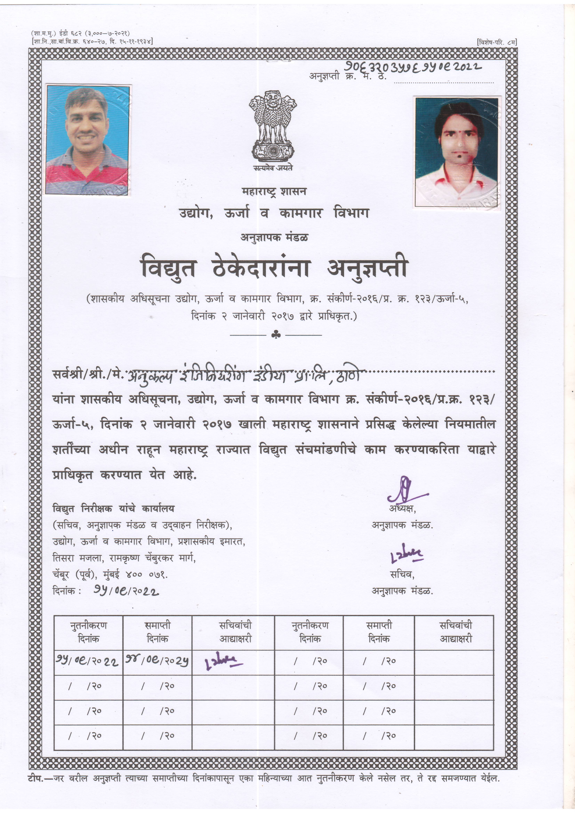
ELECTRICAL LICENCESED CONTRACTOR

Slide 15
Recent projects

Slide 16
Alstom Madhepura (Bihar)

Slide 17
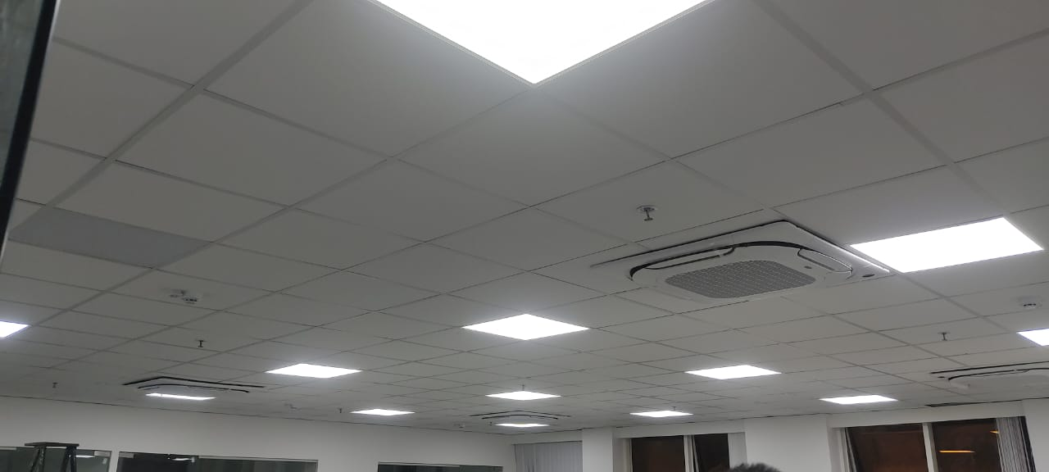
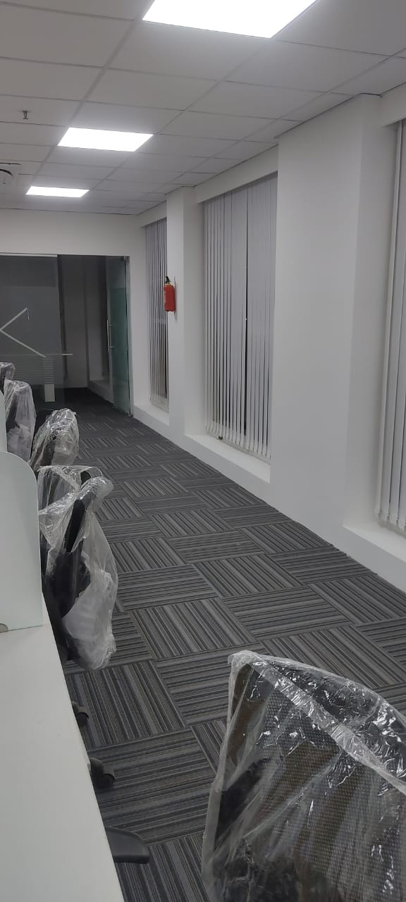
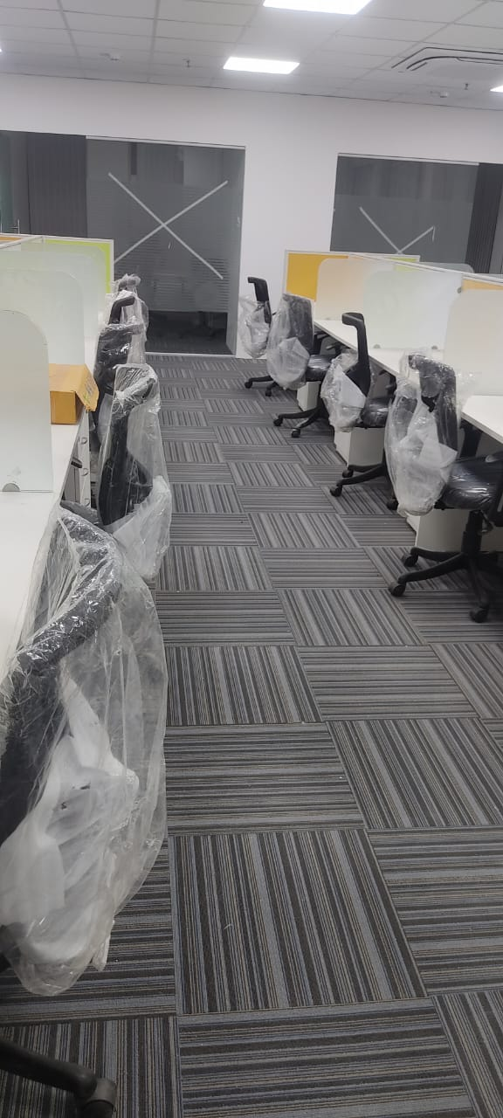
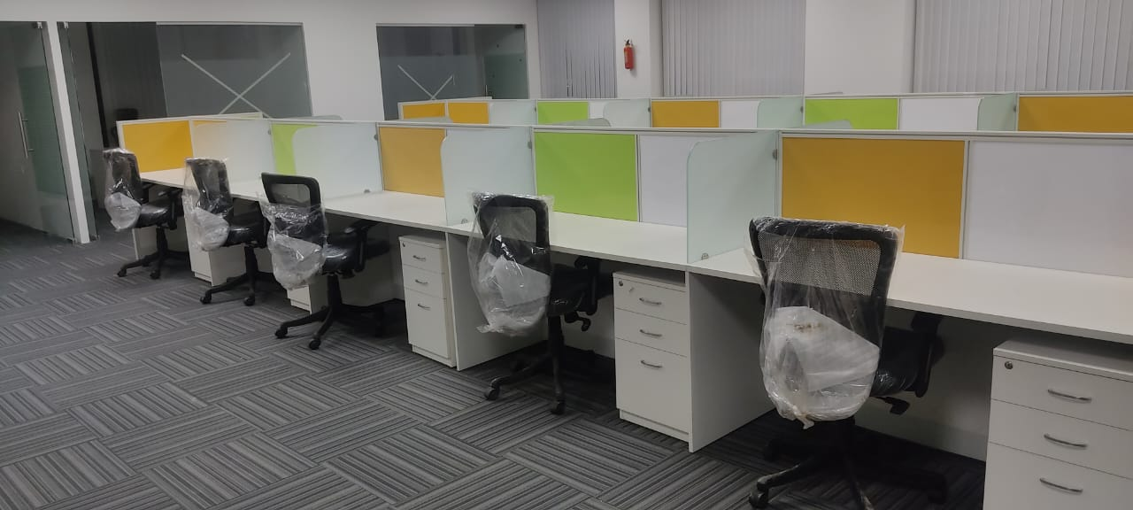
Alstom Office Indore

Slide 18
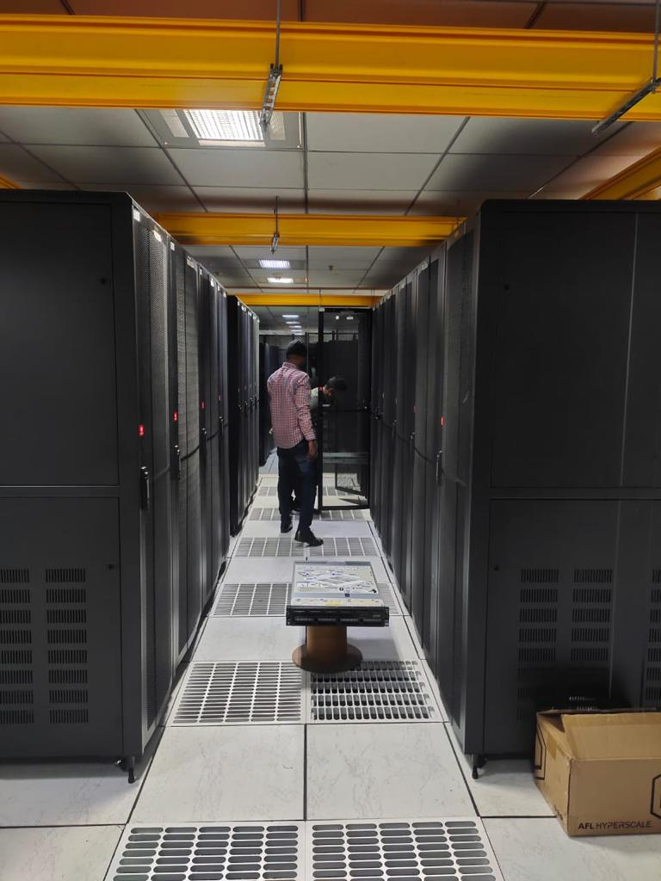
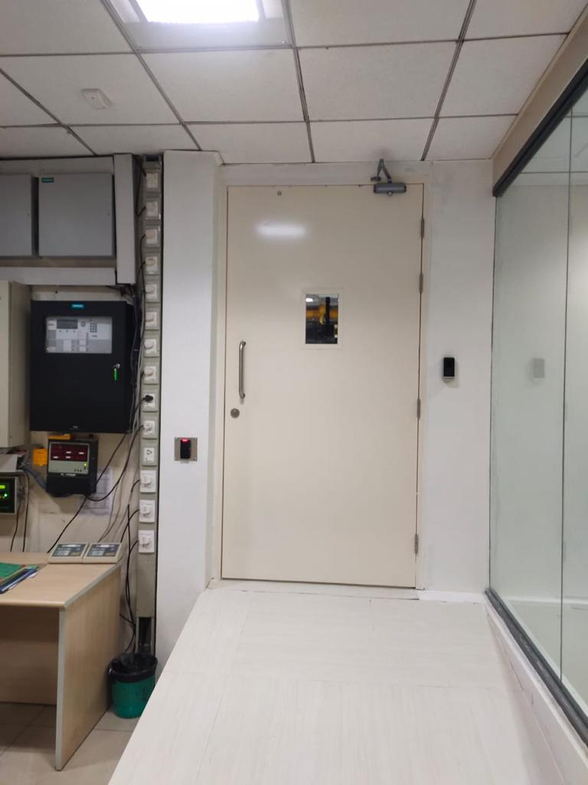
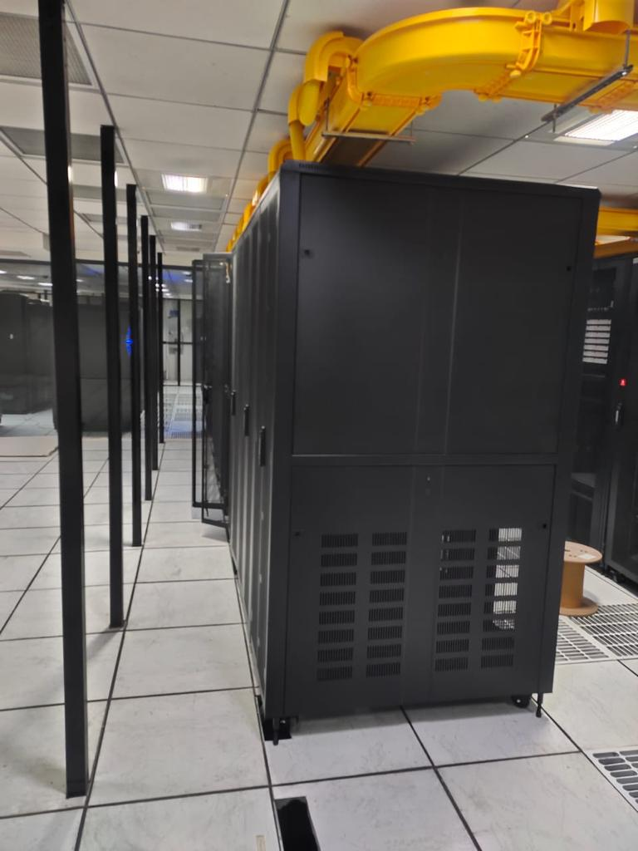
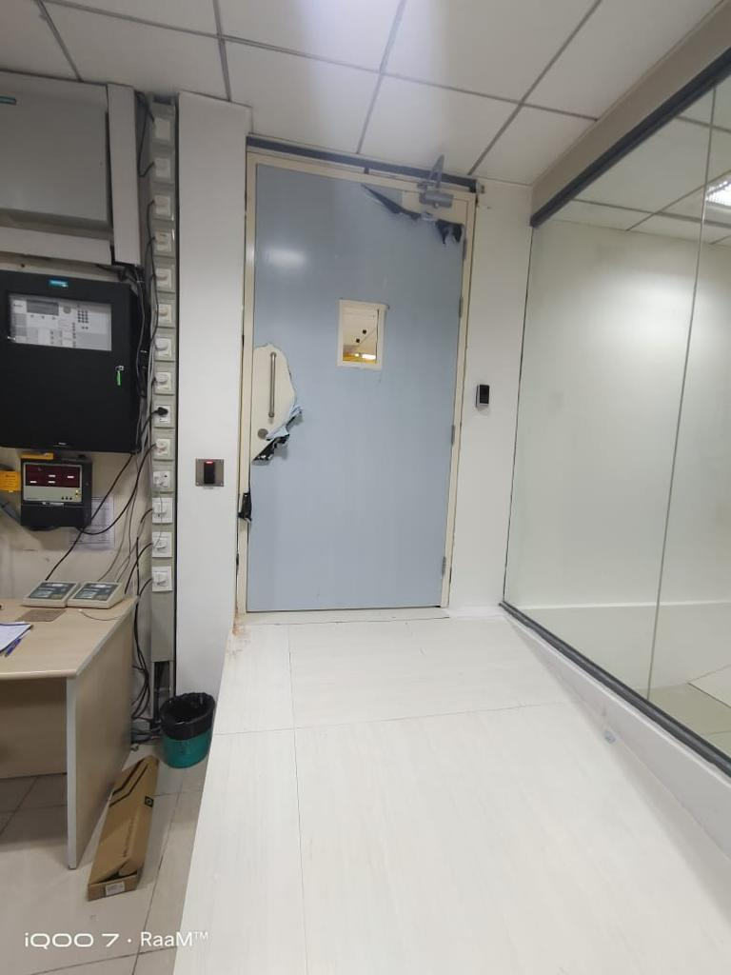
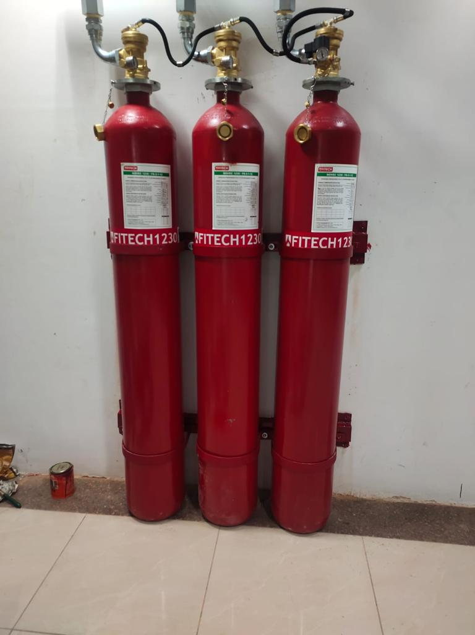
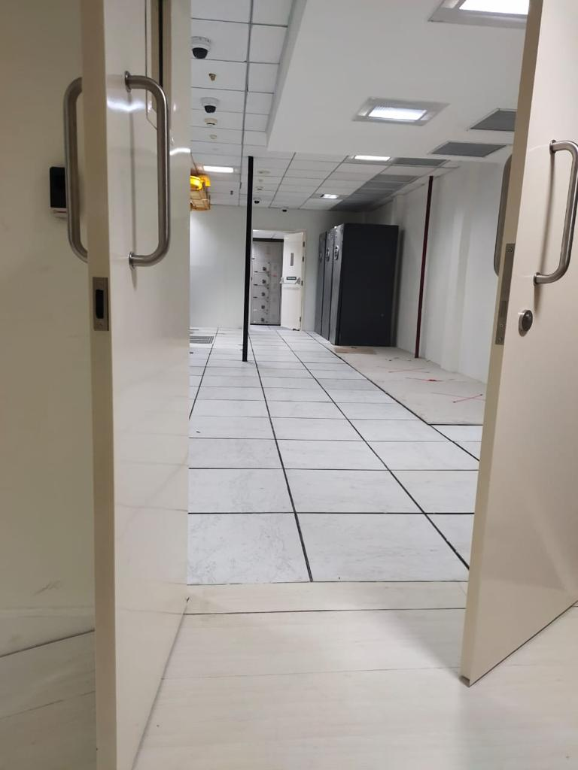
STPI CHENNAI DATA CENTRE

Slide 19
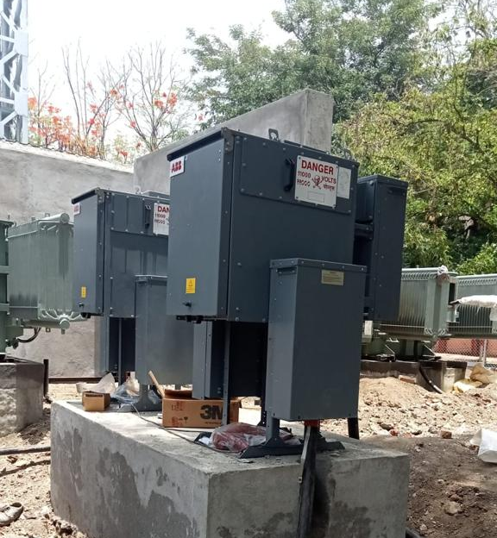
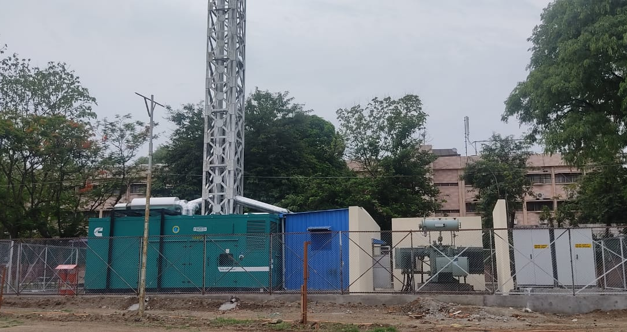
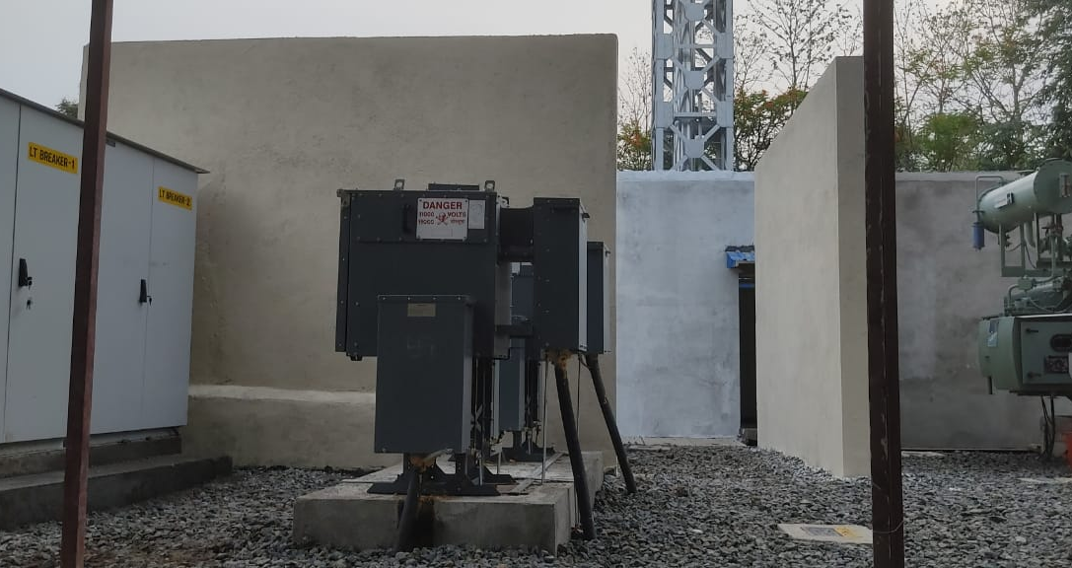
RBI Nagapur Data Centre

Slide 20
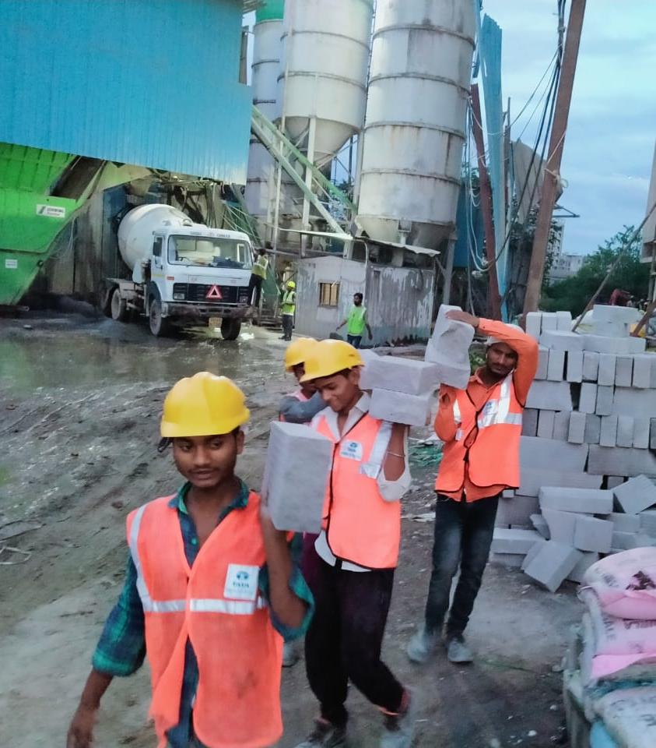
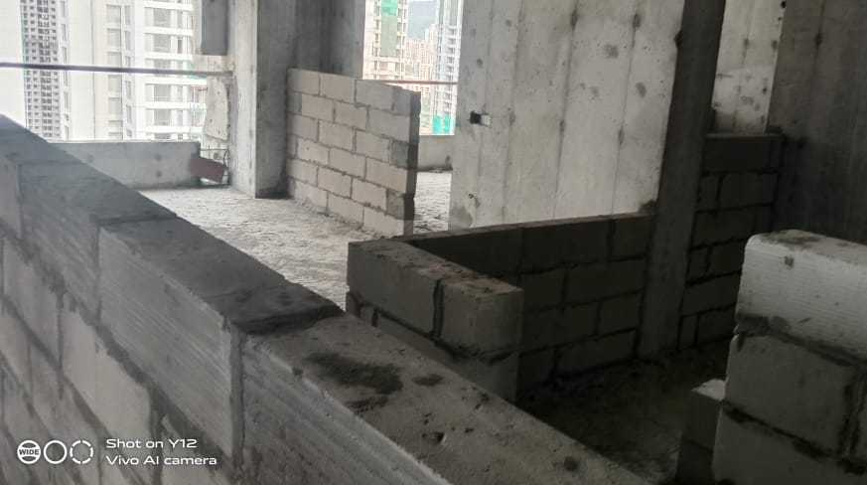
Tata Project LTD Balkumbh (Thane)

Slide 21
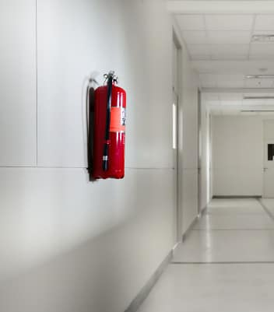
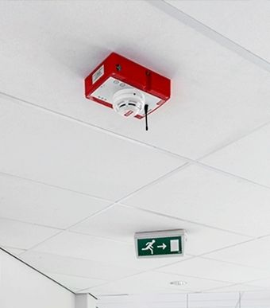
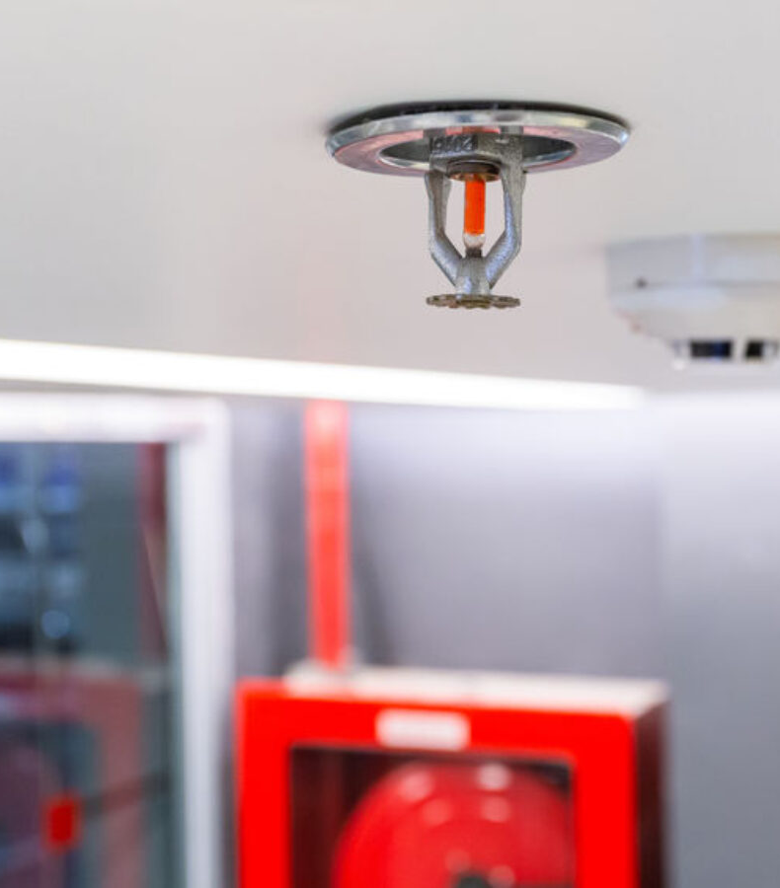
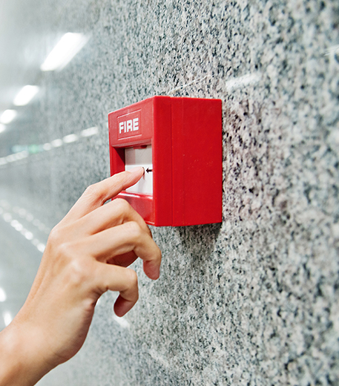
FIRE AND SAFETY

Slide 22
OUR KEY CLIENTS
Sage-Fox.com Free PowerPoint Templates

Slide 23
OUR CLIENTS
Sage-Fox.com Free PowerPoint Templates

Slide 24
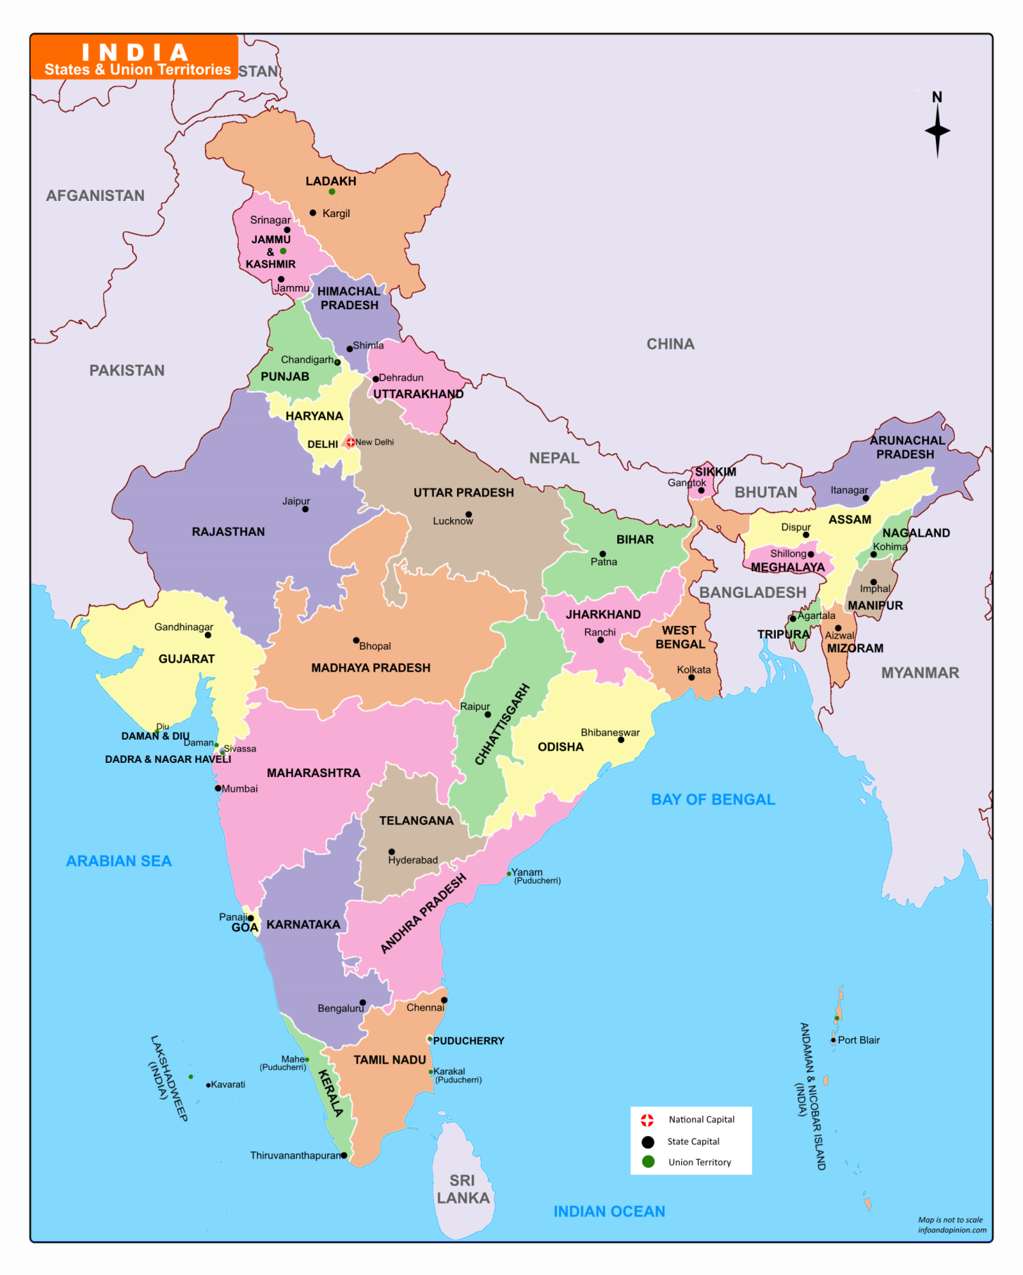
Merto Bombay Stock Exchange Data Centre Mumbai
PROJECTS IN INDIA
Sun Pharma Data Centre Jammu
Control & Command Centre Kashmiri Gate New Delhi
Control & Command Centre Deharadun
Pyrotech Work Solution, Udaipur
MELPL Loco factory Saharanpur
Civil, Electrical, & IBMS for Sagar, Jabalpur, Gwalior, Indore, Bhopal ,Ujjain, Satana.
BURL Data Centre, Beena
MELPL Loco Factory Goliath Crane, Bihar
Bombardier Vadodara
Convention Centre, Guwahati
IISER Bhopal Data Centre
IIT Pawai, Mumbai
Aircond, West Bengal
Amazon Data Centre, Gowendi, Mumbai
Metro Feeding Post work Aare, Mumbai
Samrudhhi Mahamarg Mumbai- Nagpur Highway
Reserve Bank Of India Data Centre Kharghar, Belapur, Nagpur
Metro Line 2A & 7 Earthing Project Mumbai
Orange Data Centre, Hyderabad
Metro Rail Wearhouse Project Mumbai
Metro Rail Wearhouse Project Pune
Mahindra Chakan, Maharashtra
Metro Rail Feeding post work Mumbai
Vodafone-Idea MSC Chitradurg
MTNL STPI Chennai
Bombardier Mumbai Central
Sun Pharma Data Centre, Chennai
HVAC Work Kanyakumari

Slide 25
CONTACT US
Contact us today to discuss your vision, meet our team or get a quote. We look forward to working with you
Corp Office: 178 & 179, Swami Vivekanand Colony, In from of Ondoor, Awadhapuri, Bhopal, Madhya Pradesh, India.462001
Branch Office: Anukalp House, Mauli Row House No-19, Pratibha CHS, Sector 2A, Airoli, Navi Mumbai - 400708
Phone: +91 92232 69561
+91 87883 69770
E MAIL:
vishwanath.dhatrak@anukalpengineering.com;
info@anukalpengineering.com anukalpengineer@gmail.com
WEBSITE:
www.anukalpengineering.com
Sage-Fox.com Free PowerPoint Templates

Slide 26
Thank you
info@anukalpengineering.com
www.anukalpengineering.com

